Slide 1

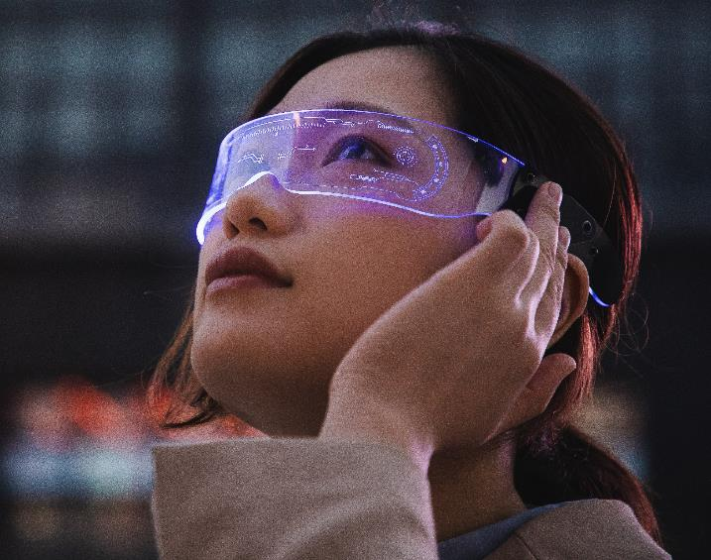
Medical Image Encryption Based on Chaotic Mapping
By:
Keshab Kumar(2201330100132)
Anshika Jaiswal(2201330100051)
Akrati Mishra(2301330109004)
Apoorva Sharma(2201330100304)

Slide 2
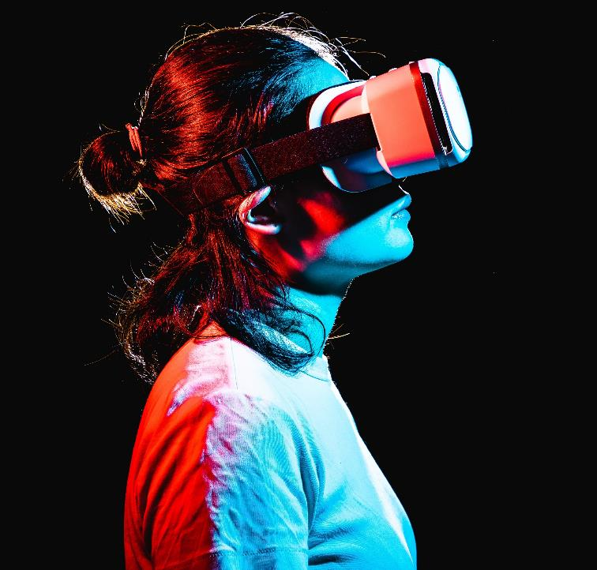
Introduction
In the era of digital healthcare, medical images such as X-rays, CT scans, and MRIs are widely used for diagnosis and treatment. These images are often stored and transmitted over networks, making them vulnerable to unauthorized access, tampering, and data theft. Protecting the confidentiality and integrity of medical images has become a critical requirement.
Traditional encryption methods like AES and DES, while secure, may be computationally intensive and not well-suited for large-scale image datasets or real-time applications. In contrast, chaotic systems offer a lightweight, highly secure alternative due to their sensitivity to initial conditions and pseudo-random behavior.
This project proposes a secure image encryption method using chaotic mapping. By utilizing the properties of chaotic systems (such as the Logistic Map), we aim to scramble and encrypt medical images in a way that ensures both privacy and efficiency. The approach involves pixel-level confusion and diffusion to make the encrypted image completely unintelligible without the proper key, thus ensuring high security in medical data handling.
.

Slide 3
ABSTRACT
Medical image encryption is vital to protect sensitive patient data during storage and transmission. Traditional encryption methods often fall short in terms of speed and efficiency, especially when handling large medical datasets.
This project proposes a novel approach using chaotic mapping techniques, such as the Logistic Map, to encrypt medical images. The method leverages the unpredictable and sensitive nature of chaotic systems to perform pixel-level confusion and diffusion, ensuring strong security.
By applying selective encryption on critical regions of interest (ROI) within medical images, the approach achieves a balance between security, performance, and storage efficiency. Experimental results show high randomness, low correlation, and strong key sensitivity—making it suitable for healthcare applications such as telemedicine, cloud storage, and AI diagnostics.

Slide 4
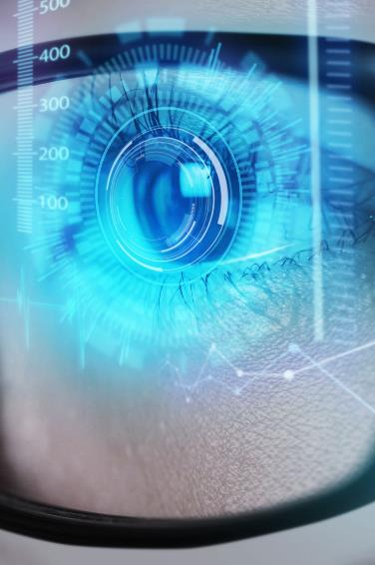
Problem Statement
With the increasing use of digital technologies in healthcare, medical images (such as MRI, CT, and X-ray scans) are frequently stored and transmitted electronically. These images contain highly sensitive patient information, making them a prime target for cyberattacks.
Traditional encryption algorithms like AES or DES, although secure, are not specifically optimized for image data. They often result in:
High computational load
Slow processing time
Poor suitability for large image datasets
There is a critical need for an encryption method that is:
Secure and reversible
Efficient in terms of speed and memory
Capable of handling full image data without loss
This project proposes a full image encryption technique using chaotic mapping, which leverages the randomness and sensitivity of chaos theory to provide a lightweight, fast, and secure solution for medical image protection.

Slide 5
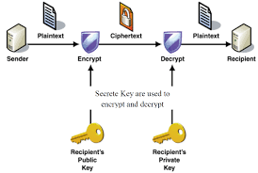
PROPOSED SOLUTION
This project proposes a Full Image Encryption algorithm based on chaotic mapping, specifically designed for securing medical images during storage and transmission.
The method consists of the following key steps:
🔸 1. Image Input
A grayscale or color medical image (e.g., X-ray, MRI) is taken as input.
🔸 2. Chaotic Key Generation
A chaotic map (e.g., Logistic Map) is used to generate a pseudo-random sequence based on initial conditions (secret keys).
🔸 3. Confusion Phase (Pixel Position Shuffling)
The pixel positions of the image are randomly permuted using the chaotic sequence to break spatial relationships.
🔸 4. Diffusion Phase (Pixel Value Modification)
Pixel values are altered using operations like XOR with chaotic values, ensuring that a small change in the image or key results in a completely different output.
🔸 5. Output: Encrypted Image
The resulting image is unintelligible without the correct key, ensuring strong protection.
🔸 6. Decryption
The process is completely reversible using the same chaotic key and inverse operations.
🔒 This approach ensures high-level security, efficiency, and suitability for real-time medical applications.

Slide 6
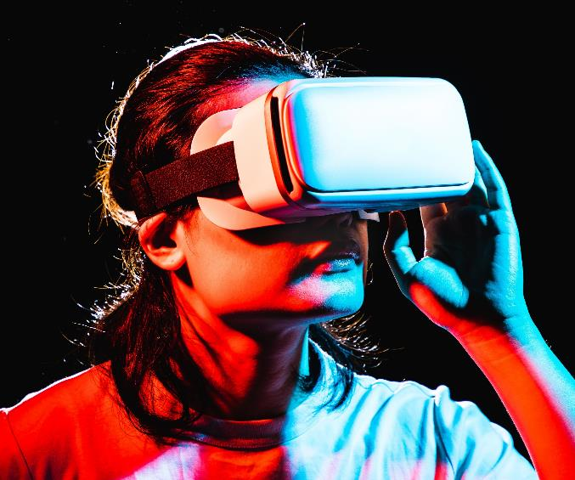
TECHNICAL IMPLEMENTATIONS
​​ The proposed medical image encryption technique is implemented using programming languages such as Python, MATLAB, or C++, leveraging image processing libraries like OpenCV or MATLAB’s Image Processing Toolbox. The encryption process begins by taking a medical image, either grayscale or color, as input. A chaotic map, typically the Logistic Map defined by the equation Xn+1=r×Xn×(1−Xn)X_{n+1} = r \times X_n \times (1 - X_n)Xn+1​=r×Xn​×(1−Xn​), where rrr is a control parameter between 3.57 and 4, and XXX is the initial seed, is used to generate a pseudo-random sequence that serves as the encryption key.
The encryption itself consists of two main stages: confusion and diffusion. In the confusion phase, the pixel positions of the image are shuffled based on the chaotic sequence to break the spatial correlation between pixels. This rearrangement makes it difficult for an attacker to recognize any patterns. Next, in the diffusion phase, the pixel values of the shuffled image are modified, typically using operations like XOR with values derived from the chaotic sequence, ensuring that even a slight change in the key or image results in a vastly different encrypted output. The decryption process reverses these steps using the same chaotic key, allowing perfect recovery of the original medical image. This method balances security, efficiency, and speed, making it suitable for real-time medical applications.

Slide 7
KEY FEATURES OF THE SOLUTION
High security with chaotic key
TWO phase encryption
Uses sensitive and unpredictable chaotic sequences (e.g., Logistic Map) to generate strong encryption keys.
: Combines pixel position shuffling (confusion) and pixel value alteration (diffusion) for robust protection.
EFFicient and Fast
Performance Optimization
Uses vectorized row/column shifts for fast encryption.Avoids redundant operations to reduce computational overhead.
Lightweight algorithm suitable for large medical images and real-time encryption/decryption.

Slide 8
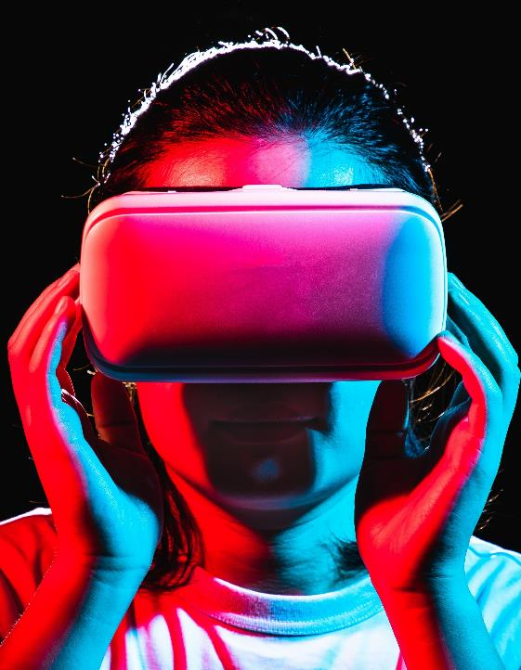
TOOLS AND TECHNOLOGY USED
PyTorch – Framework for training and deploying YOLO models.
OpenCV – Image processing and real-time video handling.
Numpy – Numerical computations for feature extraction.
spaCy , NLTK, TensorFlow / PyTorch, API – To integrate a chat bot
MACHINE LEARNING
​
React.js – Frontend for real-time video encryption UI.
Node.js & Express.js – Backend API for handling encryption requests.
FastAPI – Alternative backend for ML inference.
WebSockets – Real-time video streaming support.
Docker – Containerization for easy deployment.
IPFS – InterPlanetery File System
FULL STACK : MERN

Slide 9
APPLICATIONS
How we’ll scale in the future​
Secure Telemedicine: With the rise of telemedicine, medical images such as X-rays, MRIs, and CT scans are frequently shared over the internet for remote diagnosis and consultation. Encrypting these images ensures patient privacy and prevents interception by unauthorized parties during transmission, thereby maintaining confidentiality and compliance with healthcare regulations.
Cloud Storage Security: Hospitals and medical institutions increasingly use cloud platforms to store vast amounts of imaging data. Encrypting medical images before uploading to the cloud protects sensitive information from data breaches or insider threats, ensuring that patient records remain secure even if the cloud storage is compromised.
Confidential Data Transmission: Medical images often need to be transferred between different healthcare facilities, diagnostic centers, and specialists. Encryption ensures that these images cannot be tampered with or accessed by unauthorized users during transit, preserving both privacy and data integrity.
AI-Based Diagnostics: Artificial Intelligence (AI) and machine learning algorithms are now widely used to analyze medical images for diagnostic purposes. Encrypting images allows these sensitive data to be safely processed in secure environments, ensuring patient confidentiality while benefiting from advanced diagnostic technologies.
Hospital Surveillance Systems: Medical imaging systems and electronic health records are part of hospital networks that require constant protection from cyber threats. Encrypting medical images helps secure internal communications and data storage, safeguarding against unauthorized access and potential cyberattacks on hospital infrastructure.

Slide 10
CHALLENGES AND CONSIDERSTION
AI ACCuracy
and False
Positives
REAL TIME
PROCESSING
POWER
LEGAL AND
ETHICAL
BOUNDARIES
Performing real-time person detection and selective encryption on high-resolution video streams can be computationally expensive.
If the YOLO model mistakenly detects a non-human object as a human or fails to detect an actual human, the encryption may become inaccurate. ​
​
Some governments and organizations have strict regulations regarding the modification of surveillance footage, posing challenges in legally adopting such techniques. ​
​

Slide 11
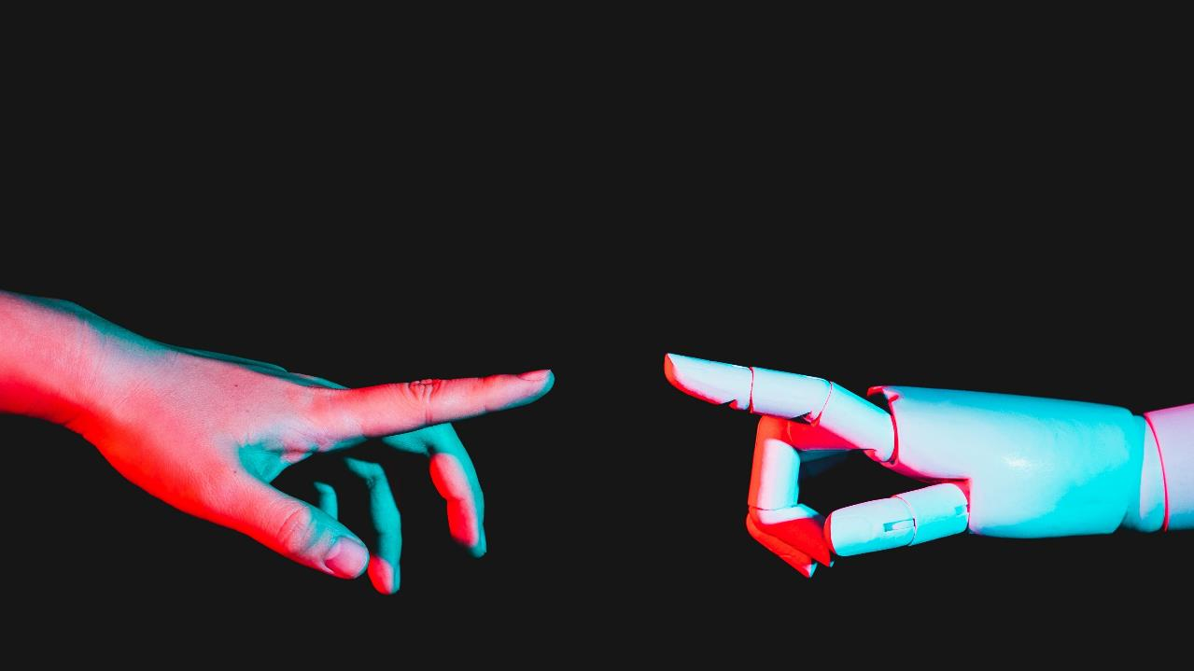

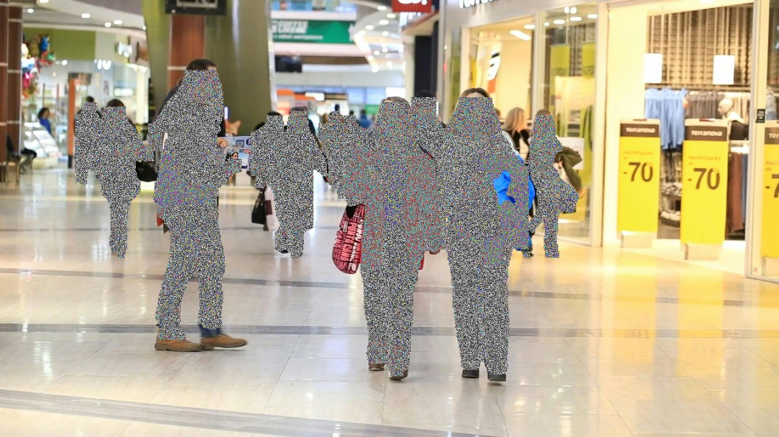

Slide 12

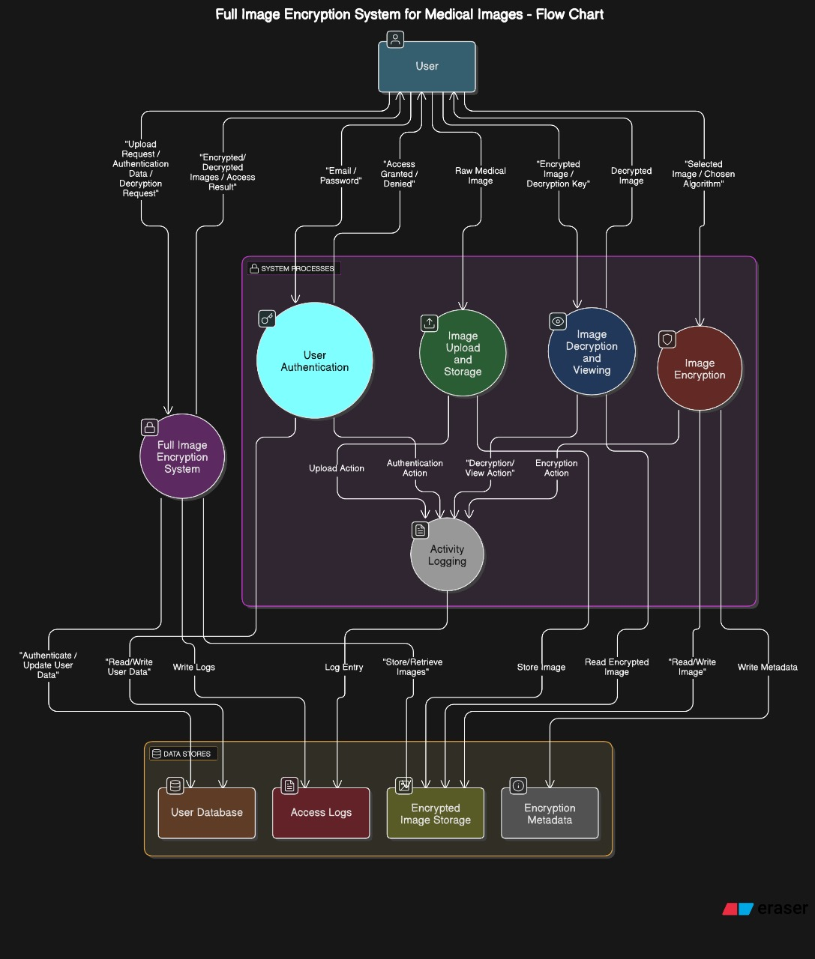
Flow Chart Diagram

Slide 13
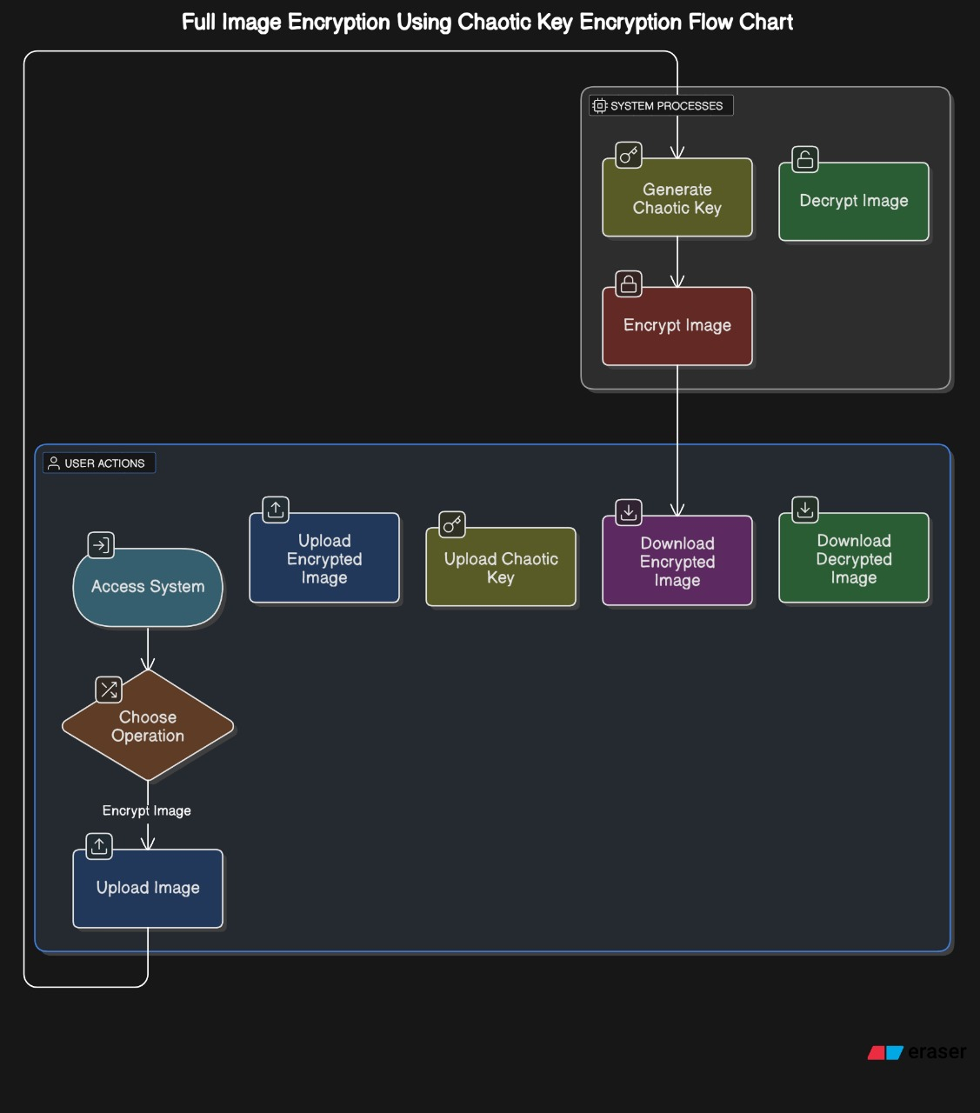
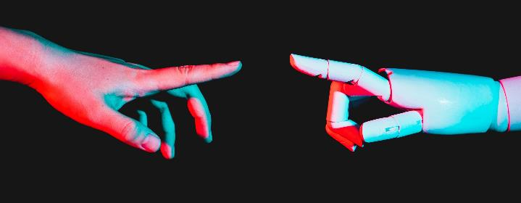

Slide 14
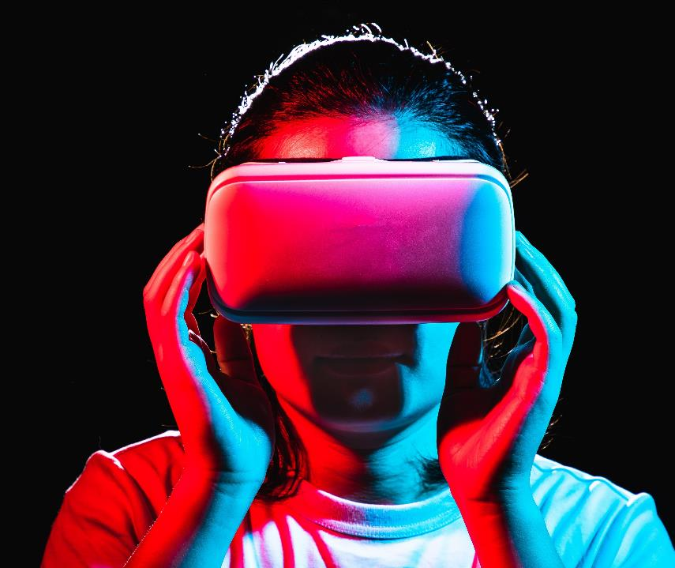
Thank you
Keshab Kumar​​
Anshika Jaiswal
Akrati Mishra
Apoorva Sarma

